Slide 1


PROJECT REVIEW
ADDITIVELY MANUFACTURED PULSE OXIMETER
PROJECT GUIDE
Mr.K.Pradeep M.Tech, (Ph.D)
Assistant Professor,
Department of Biomedical Engineering
PRESENTED BY
INDHUJA S [22BM016]
JAYASHREE S [22BM017]
SWETHA A [22BM052]

Slide 2
OBJECTIVE
To 3D print pulse oximeter and monitor the value of SpO2 in a website.

Slide 3
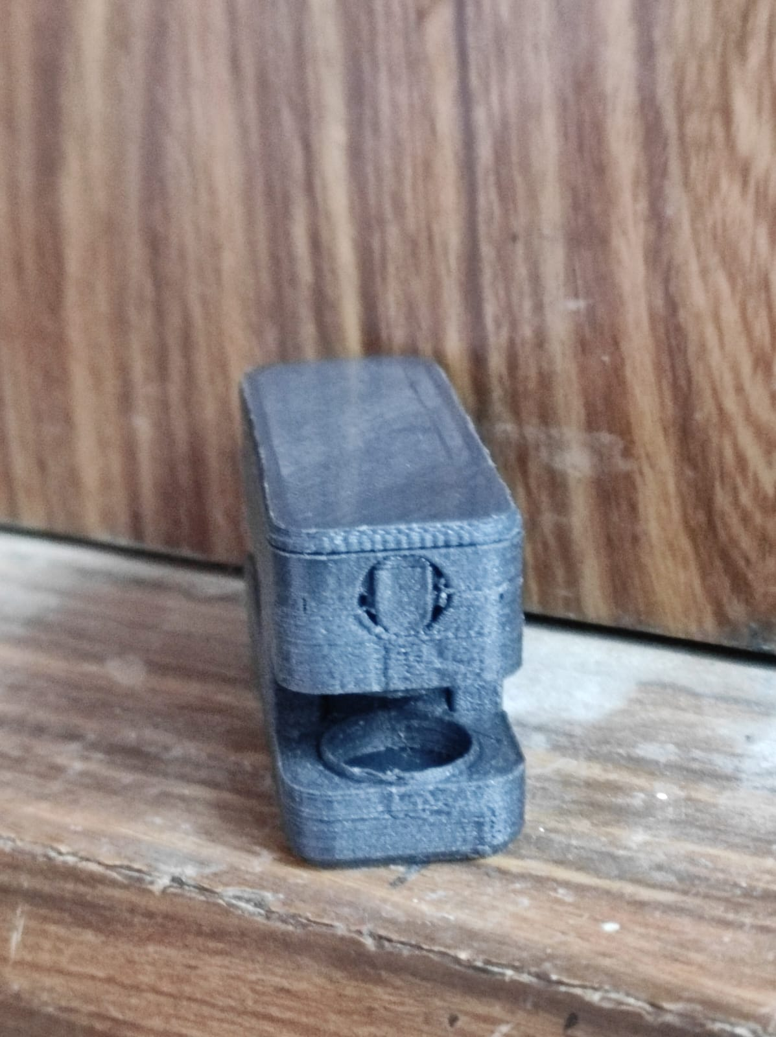
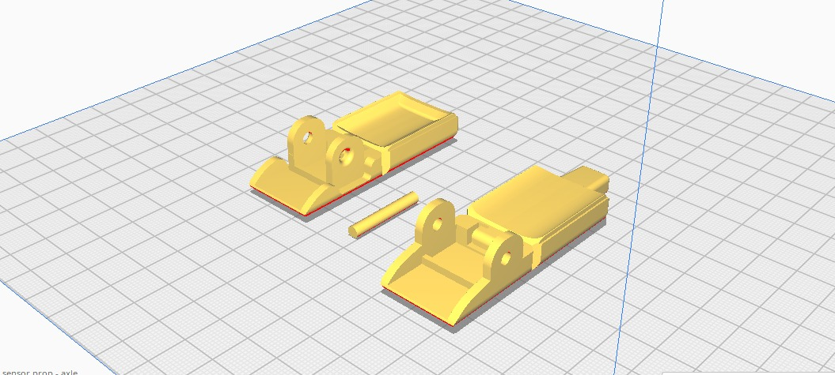
DESIGN
FIRST PROTOTYPE

Slide 4
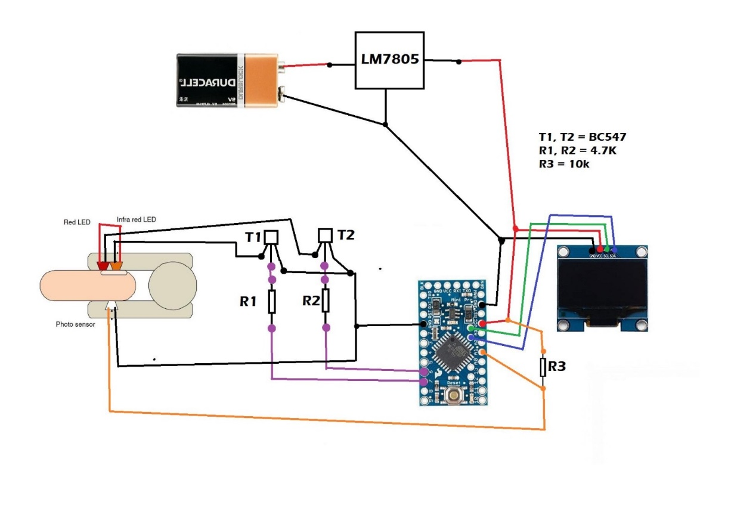
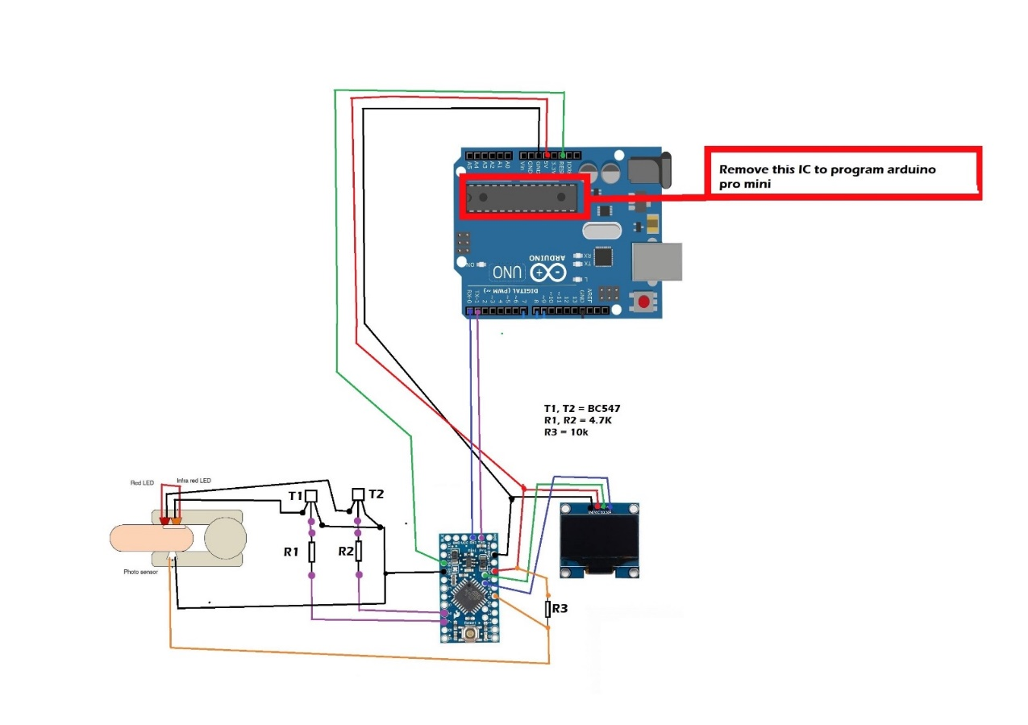
CIRCUIT DIAGRAM

Slide 5
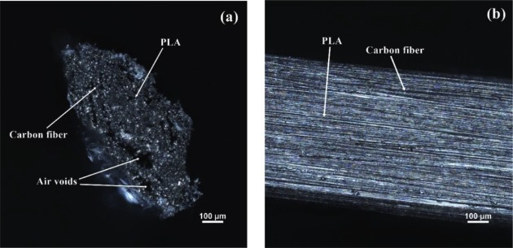
CARBON REINFORCED PLA

Slide 6
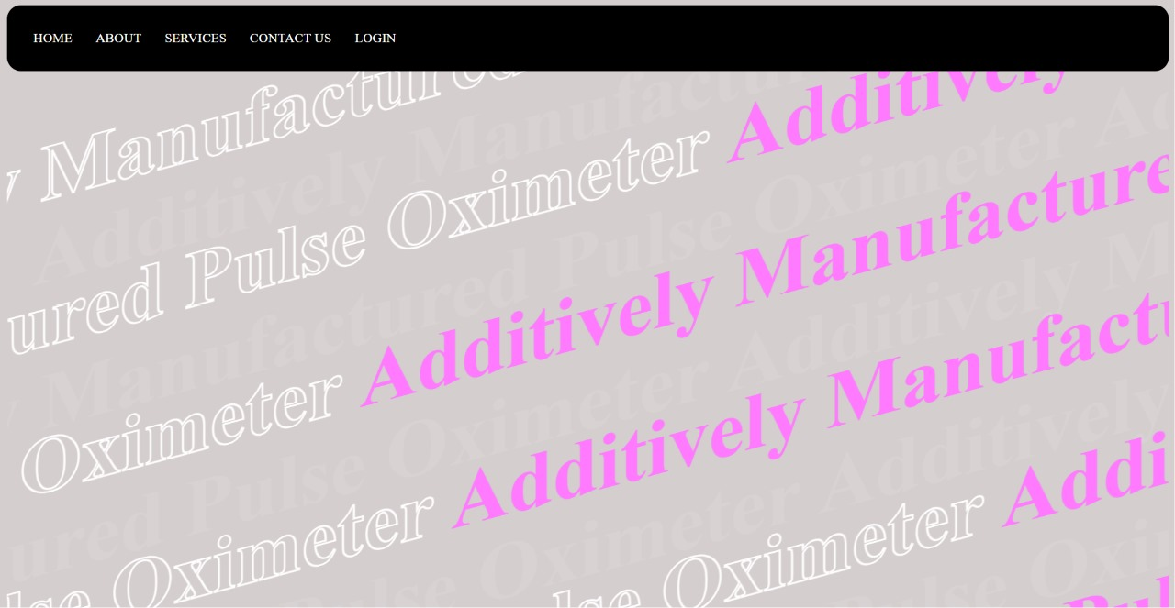
WEBSITE MODEL HEATHER’S HEALTHCARE PRODUCTS

Slide 7
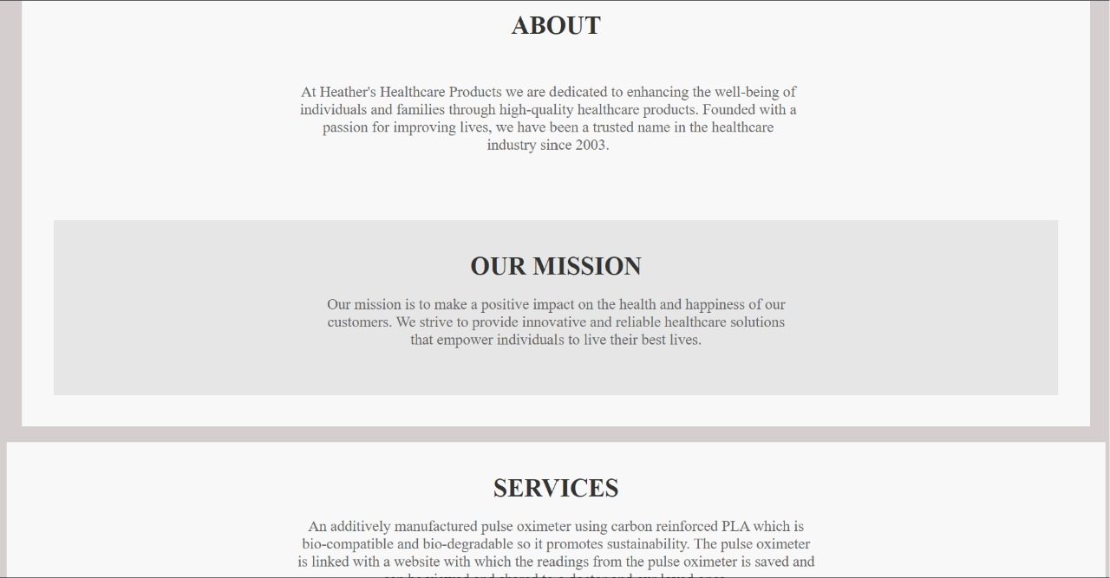
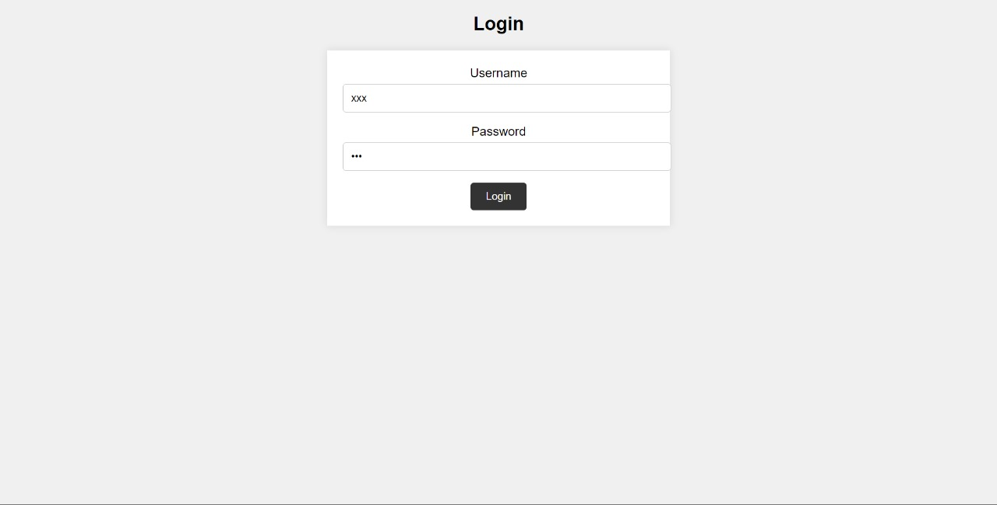
WEBSITE

Slide 8
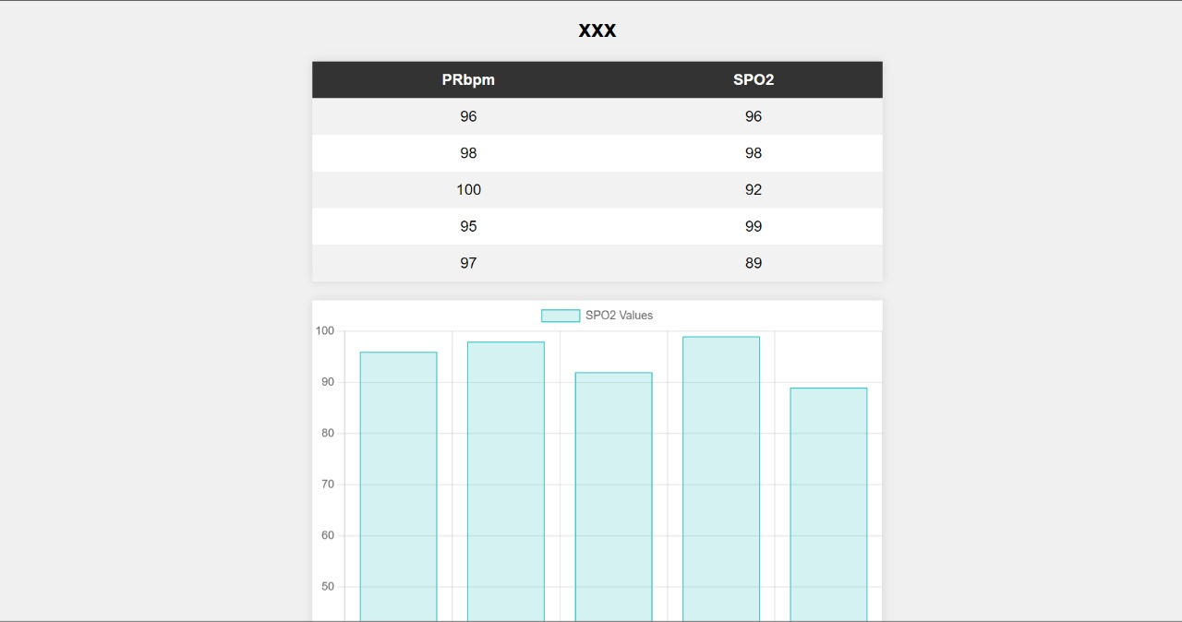
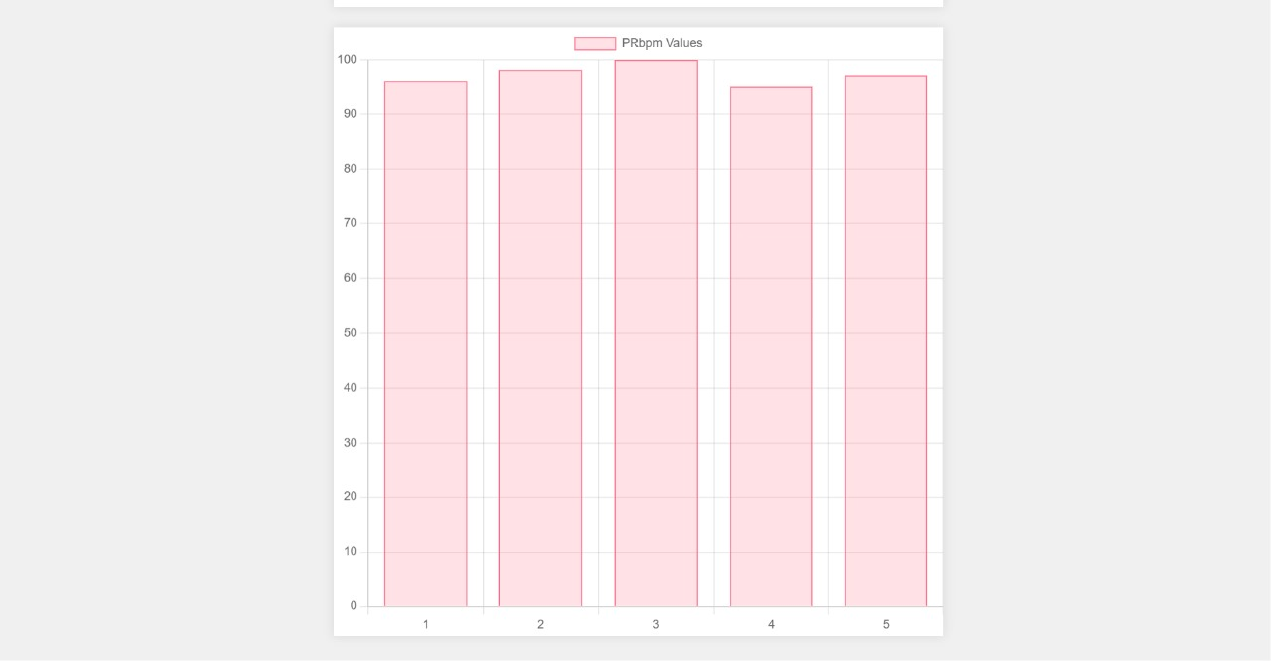
WEBSITE

Slide 9
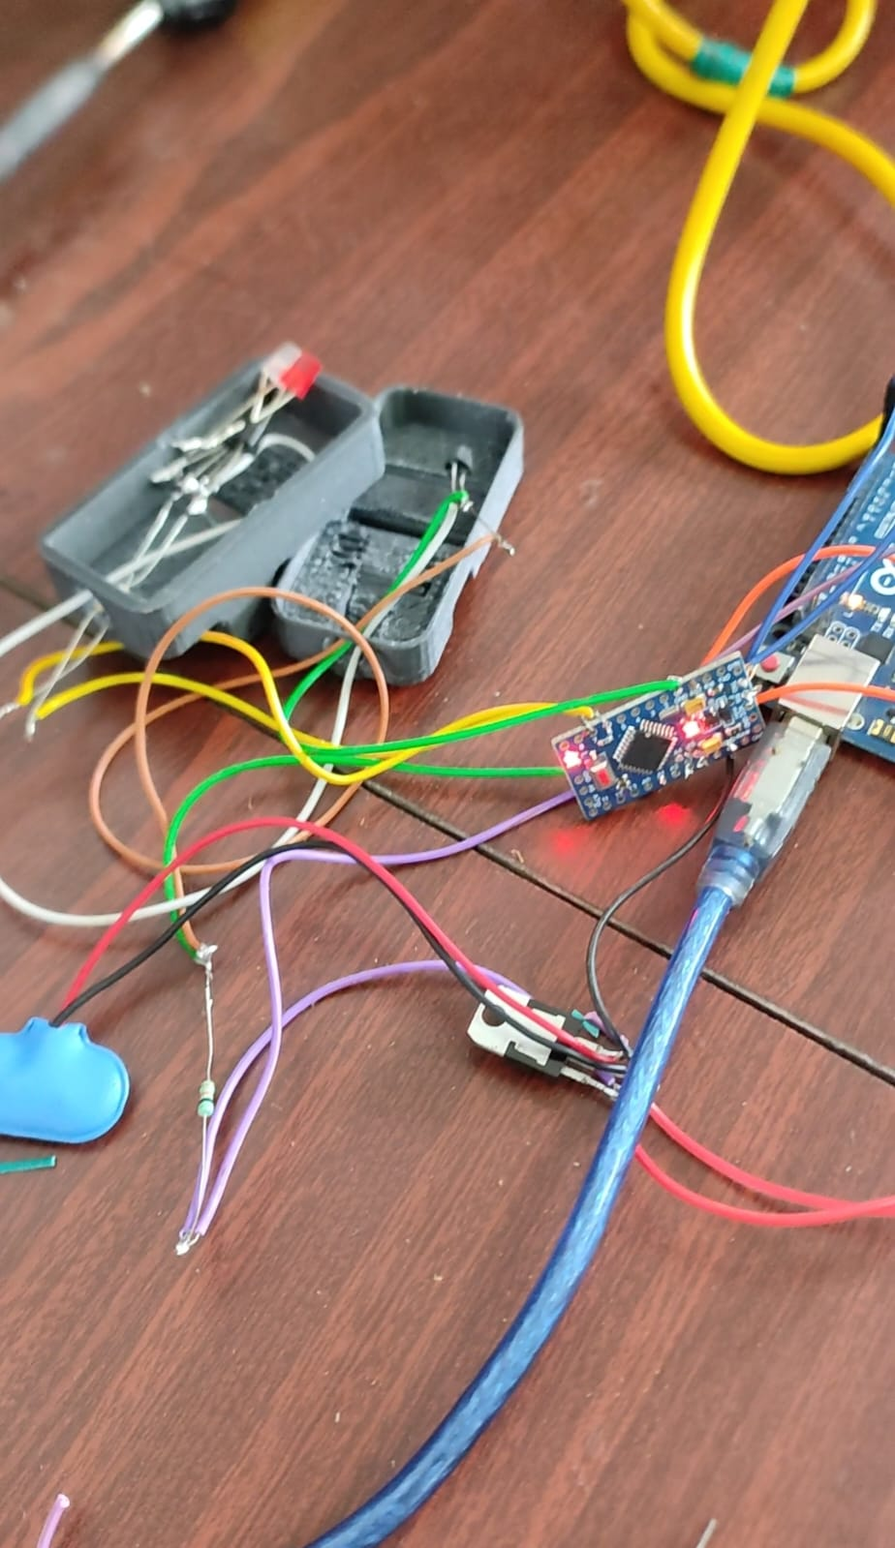
PROJECT IMAGE

Slide 10
APPLICATIONS
1. To monitor the spo2 level in the human body.
2. To be able to view the oxygen saturation levels on a website
3. share the details with our family members and doctor.

Slide 11
PUBLICATIONS
capobussi2020[1].pdf
10.1002@adhm.201901735[1].pdf
file:///C:/Users/jayas/AppData/Local/Microsoft/Windows/INetCache/IE/ON0OOTCI/10.1016@j.prostr.2020.04.056[1].pdf
file:///C:/Users/jayas/AppData/Local/Microsoft/Windows/INetCache/IE/MCRKNLZ4/1-s2.0-S2468067222000542-main[1].pdf

Slide 12
THANK YOU

